Slide 1
Bank Marketing
By Wilbert Rodriguez and Tommy Le

Slide 2

Bank Marketing
Bank Marketing refers to strategies that are undertaken by banks
Promote their products and services to customers
Attract new clients
It helps build brand awareness, increases customer engagement, and ultimately helps the business growth of the bank
Some of its components are product promotion, target audience, advertising, and promotion

Slide 3
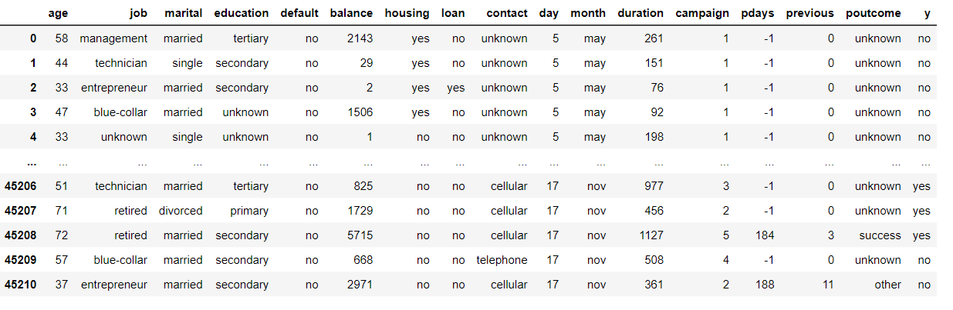
The Bank Marketing Data
The Data we obtained is on direct marketing campaigns(phone calls) of a Portuguese banking institution
The classification goal is to predict if the client will subscribe a term deposit
Notes:
UCI Machine Learning Repository: Bank Marketing Data Set
Input variables: # bank client data: 1 - age (numeric) 2 - job : type of job (categorical: 'admin.','blue-collar','entrepreneur','housemaid','management','retired','self-employed','services','student','technician','unemployed','unknown') 3 - marital : marital status (categorical: 'divorced','married','single','unknown'; note: 'divorced' means divorced or widowed) 4 - education (categorical: 'basic.4y','basic.6y','basic.9y','high.school','illiterate','professional.course','university.degree','unknown') 5 - default: has credit in default? (categorical: 'no','yes','unknown') 6 - housing: has housing loan? (categorical: 'no','yes','unknown') 7 - loan: has personal loan? (categorical: 'no','yes','unknown') # related with the last contact of the current campaign: 8 - contact: contact communication type (categorical: 'cellular','telephone') 9 - month: last contact month of year (categorical: 'jan', 'feb', 'mar', ..., 'nov', 'dec') 10 - day_of_week: last contact day of the week (categorical: 'mon','tue','wed','thu','fri') 11 - duration: last contact duration, in seconds (numeric). Important note: this attribute highly affects the output target (e.g., if duration=0 then y='no'). Yet, the duration is not known before a call is performed. Also, after the end of the call y is obviously known. Thus, this input should only be included for benchmark purposes and should be discarded if the intention is to have a realistic predictive model. # other attributes: 12 - campaign: number of contacts performed during this campaign and for this client (numeric, includes last contact) 13 - pdays: number of days that passed by after the client was last contacted from a previous campaign (numeric; 999 means client was not previously contacted) 14 - previous: number of contacts performed before this campaign and for this client (numeric) 15 - poutcome: outcome of the previous marketing campaign (categorical: 'failure','nonexistent','success') # social and economic context attributes 16 - emp.var.rate: employment variation rate - quarterly indicator (numeric) 17 - cons.price.idx: consumer price index - monthly indicator (numeric) 18 - cons.conf.idx: consumer confidence index - monthly indicator (numeric) 19 - euribor3m: euribor 3 month rate - daily indicator (numeric) 20 - nr.employed: number of employees - quarterly indicator (numeric) Output variable (desired target): 21 - y - has the client subscribed a term deposit? (binary: 'yes','no')

Slide 4
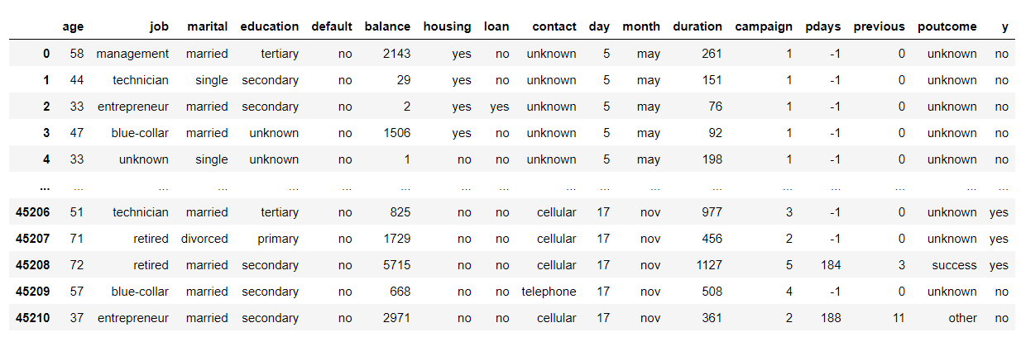
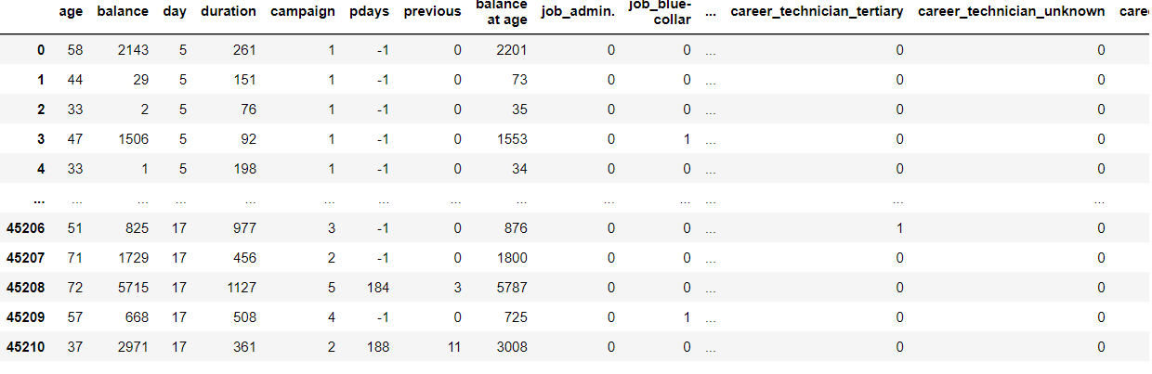
Data Before and After Preprocessing
The dataset didn’t have any missing data
It did have a lot of categorical features.
This is where we used one-hot encoding
Notes:
One-hot encoding is a technique used in data preprocessing to convert categorical variables into a binary representation that machine learning algorithms can understand. It is particularly useful when dealing with categorical features that have no inherent numerical meaning or hierarchy.

Slide 5
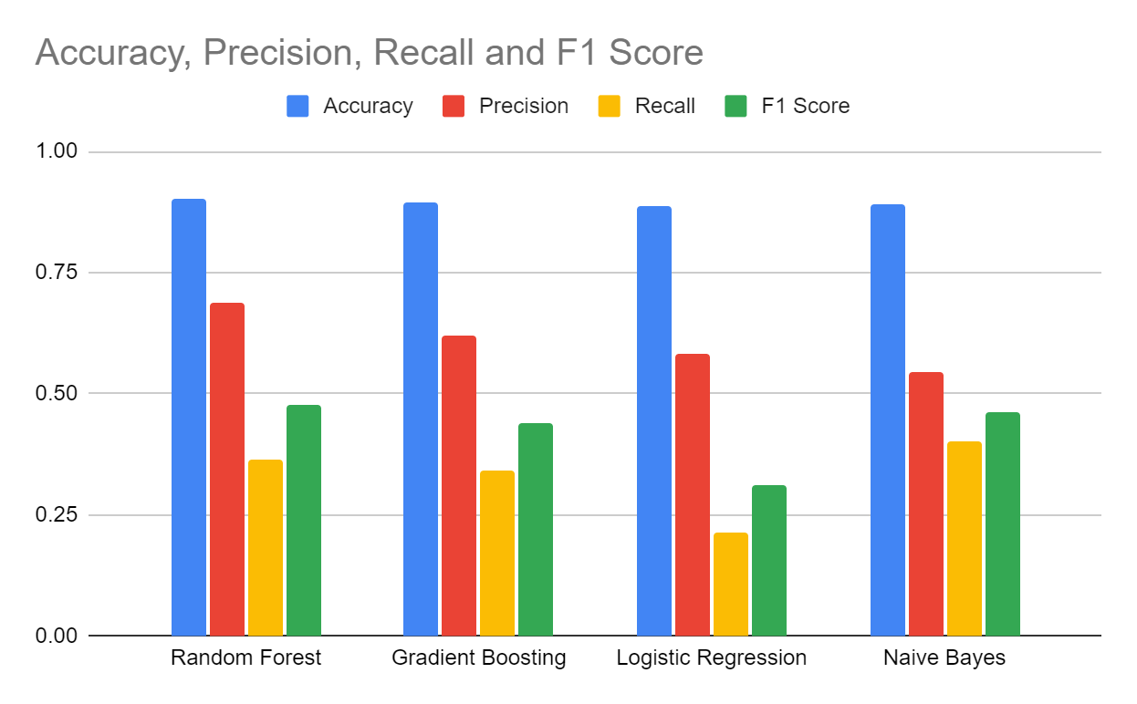
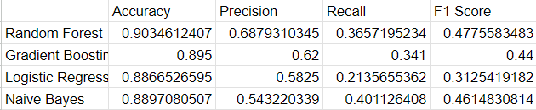
Machine Learning Techniques
Random Forest
Gradient Boosting
Logistic Regression
Naive Bayes
Notes:
Random Forest: Random Forest is an ensemble learning algorithm that combines multiple decision trees to make predictions. It is known for its robustness, scalability, and ability to handle high-dimensional data. Random Forest can effectively handle both categorical and numerical features, handle missing values, and provide insights into feature importance. It can capture complex relationships and interactions within the data, making it suitable for bank marketing data with potentially non-linear patterns and multiple predictors.
Gradient Boosting: Gradient Boosting is another ensemble learning technique that sequentially builds a set of weak learners (usually decision trees) to create a strong predictive model. It is particularly effective in handling imbalanced datasets, where the positive and negative classes are unevenly distributed. Gradient Boosting can learn from misclassified samples and adaptively improve its predictions, making it well-suited for bank marketing data with class imbalance. It can also capture complex interactions and provide accurate predictions.
Logistic Regression: Logistic Regression is a widely-used linear classification algorithm that models the relationship between the independent variables and the binary outcome variable. It is interpretable, computationally efficient, and can handle large datasets. Logistic Regression can provide insights into the impact of individual predictors on the likelihood of a positive outcome (e.g., customer subscribing to a bank product). It is suitable for bank marketing data when the goal is to understand the influence of specific factors on customer behavior.
Naive Bayes: Naive Bayes is a probabilistic classifier based on Bayes' theorem and assumes that features are conditionally independent. It is computationally efficient, easy to implement, and performs well with high-dimensional data. Naive Bayes can handle categorical and numerical features, making it suitable for bank marketing data with diverse types of predictors. It works well in situations where the assumption of feature independence holds reasonably well. Naive Bayes can provide fast and reliable predictions, making it a good choice for real-time or large-scale applications.

Slide 6
Results
From our analysis, the best technique would be Random Forest
It has the best accuracy, precision, and F1 score with Recall going to Naive Bayes
That means the Random Forest has the best overall correctness, precision of positive predictions, and the balance between precision and recall although it may struggle to identify all positive instances correctly.

Slide 7
Thank you
For Listening

